Slide 1
Low Radon Cleanroom at the University of Alberta
Darren Grant, Aksel Hallin, Steve Hanchurak, Carsten Krauss, Shengli Liu, Richard Soluk

Slide 2
Radon Clean Laboratory Concept
Tolerable Rn load
= Rn scrubber flow rate times
Acceptable Rn concentration
= 3 m³/min x 94 Rn/m³
= 282 Rn/min
.00002 Bq/m³
9.4 ²²²Rn/m³
3m x 10m x 10m
90 m³ room
140 m² area
28 Rn/min
3 m³/min
Radon
scrubber
(1 cfm)
(100 cfm)
Radon
scrubber
Lights
emanation
23 Rn/min
If walls 10 Rn/m²hr
Electrostatic
deposition plates
HEPA
20 Bq/m³
9.4x10⁶ ²²²Rn/m³
Leaks/diffusion
23 Rn/min
Cooler
30 m³/min
Baffle
Chemical
Baths?
2 Bq/m³
940,000 ²²²Rn/m³
Lab
Equipment
People/
processes
Air Lock
#2
Air Lock
#1
9,400 ²²²Rn in lungs
125,000 ²²²Rn dissolved
o
o
.0002 Bq/m³
94 ²²²Rn/m³
8460 ²²²Rn total
Class 1000 Clean Room?
80 Rn/min
.02 Bq/m³
9,400 ²²²Rn/m³
48 Rn/min
80 Rn/min
K. McFarlane
May 16, 2006

Slide 3
Radon Stripping
A hybrid design will be used combining both cryogenic and pressure/vacuum swing carbon adsorption techniques
Under normal operation 3 of the tanks will be maintained at -60C and 2 of the tanks will operate at room temperature in a pressure/vacuum swing configuration
All major components and valves are automated and will be managed by process control software

Slide 4
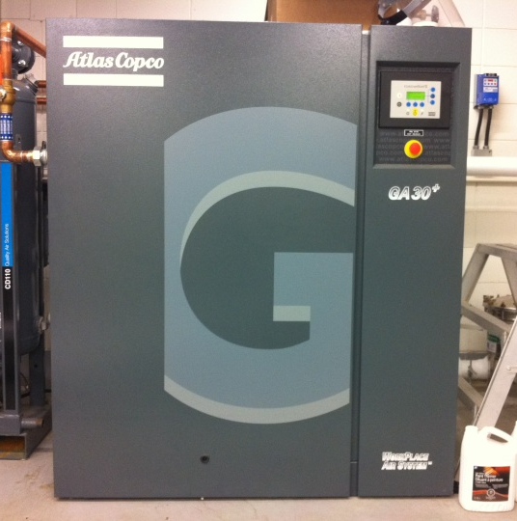
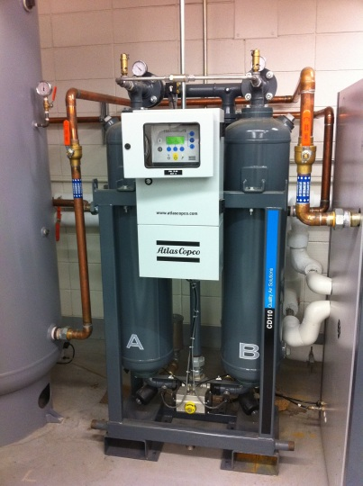
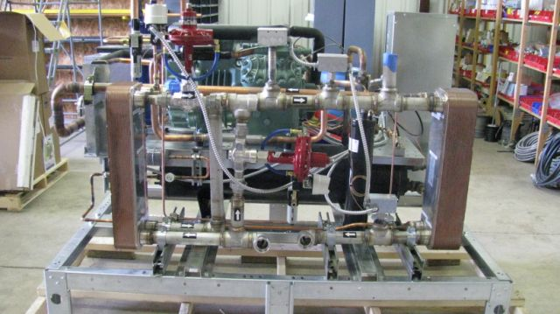
Radon Stripping Equipment
Atlas Copco GA30+ 30kW water cooled compressor (180CFM)
CD110 desiccant drier (-70C dewpoint)
Custom built 9kW water cooled process chiller (-65C operating temperature, 4.5kW cooling capacity)
Air to air heat exchanger for heat recovery, with a variable bypass to regulate chiller load and air temperature

Slide 5
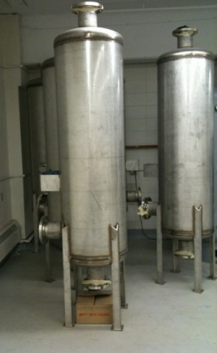
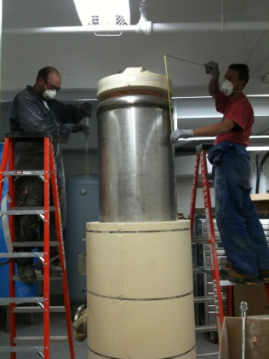
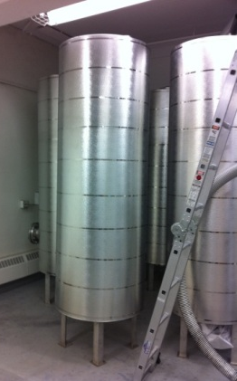
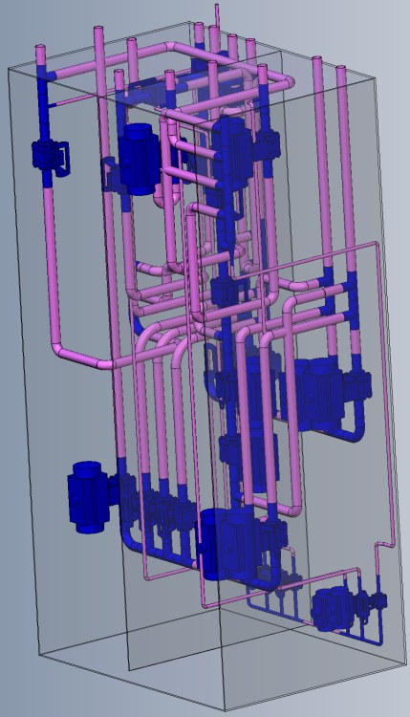
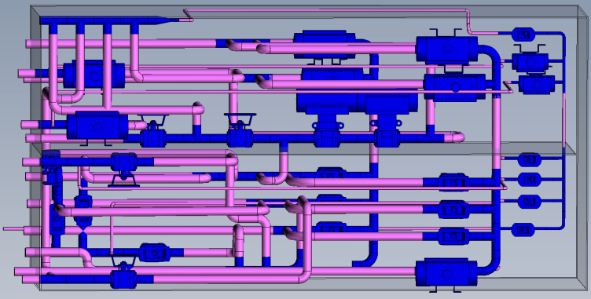
Radon Stripping Equipment
5 stainless steel tanks filled with approx. 200kg each of coconut carbon
All control valves are in a custom insulated cabinet, half of which is insulated, sealed and kept at -60C the other half is at room temperature and purged with low radon processed air
Almost all non-welded connections in the piping system will be in this 3’x5’x8’ cabinet

Slide 6
CCIS Layout
Process air will feed a sealed cleanroom in the basement of the new CCIS building (which will be completed early 2011)
A small machine shop will be installed in the cleanroom for detector fabrication
Included will be a CNC mill and lathe and both horizontal and vertical bandsaws as well as work tables and hand tools
A water purification system located outside the room will provide low radon water

Slide 7
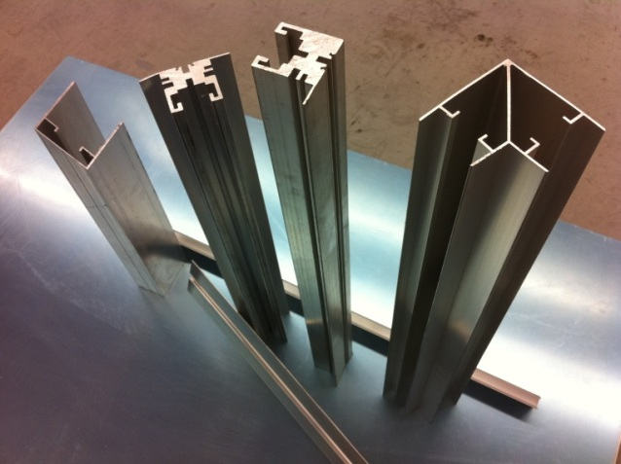
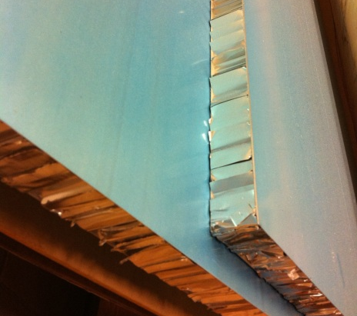
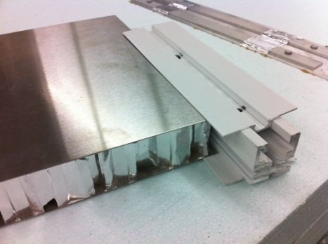
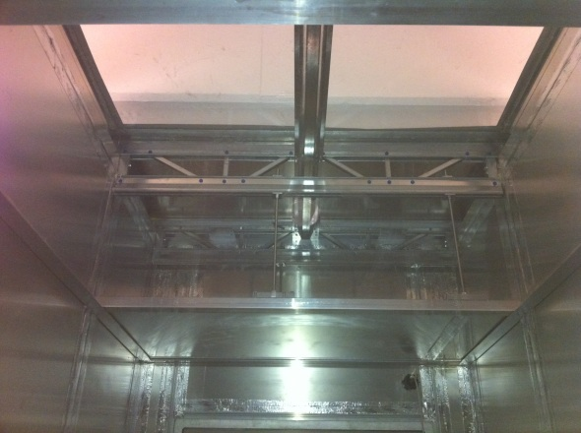
Cleanroom Construction
Cleanroom is a modular design using mill finish aluminum extrusions and panels produced by CleanAir Solutions
Basic wall panel consists of two sheets of aluminum sandwiching an aluminum foil honeycomb
Walls are 2” thick, ceiling panels use the same design but are ½” thick, standard panel size is 4’x10’
Cleanroom ceiling consists of a top plenum cap 10’ high which provides the outer air seal and an 8’ suspended inner ceiling holding the lights and HEPA filters

Slide 8
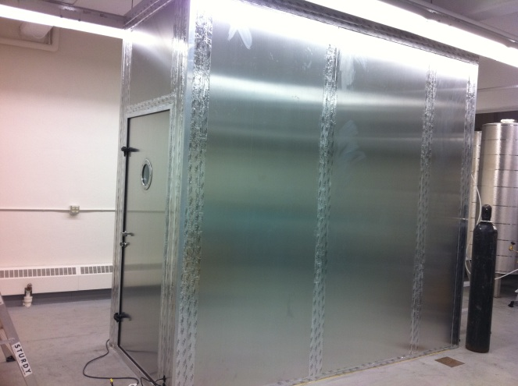
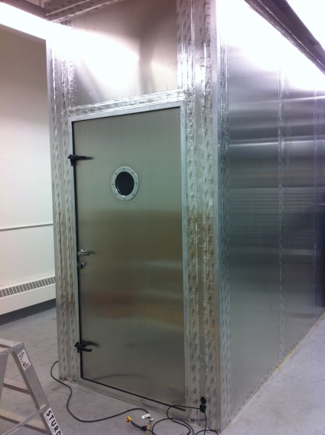
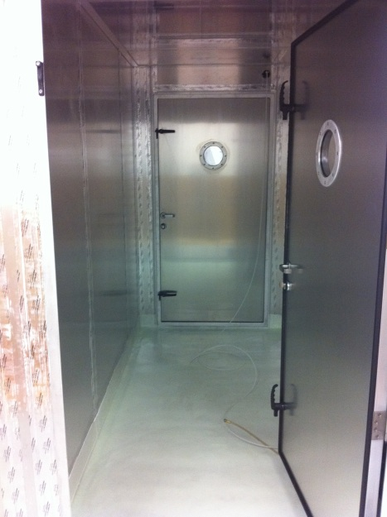
Airlock Prototype
The outer 5’x10’ airlock has been built as a prototype to test how well this cleanroom can be sealed
Doors are hollow aluminum filled with polyurethane prehung on welded aluminum frames with compression seals and additional dogs to increase clamping force between the door and frame
The floor is sealed with a 1cm thick layer of Precidium 550D a spray on polyurea industrial floor coating

Slide 9
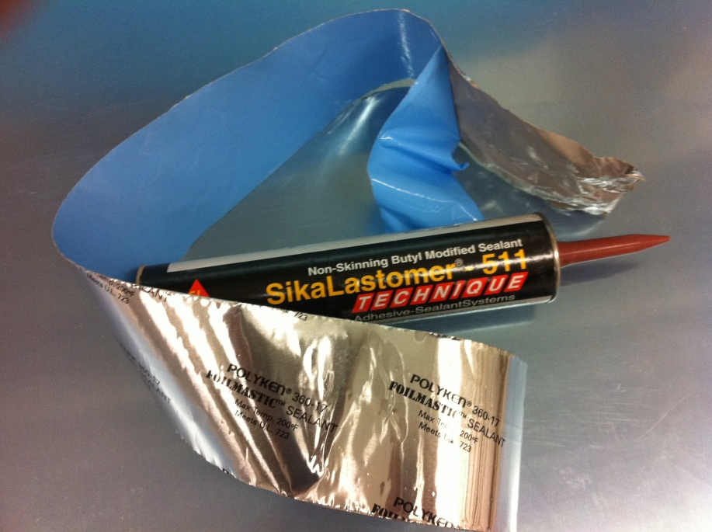
Airlock Prototype (2)
All Al-Al joints, such as wall panel seams are sealed on both the inner and outer surfaces using SikaLastomer 511 butyl caulking
All seams are then also covered, on both the inside and outside of the airlock with a layer of Polyken 360-17 aluminum foil backed butyl tape, this provides an additional layer of sealant and also covers the non-hardening butyl caulking

Slide 10
Monitoring Systems
All based on electrostatic separation and solid state detection
Currently have RAD7 commercial detector, emanation chamber and tunnel detector running
Electronics records up to 24 channels of self triggered events. Time and energy are calculated and stored for each event

Slide 11
Radon Monitor: detector head and preamp box
-HV
Preamplifier and shaping box:
Attached to detector
Charge
Sensitive
Shaping &
gain
To DAQ board
50 ohm coax.
S3204

Slide 12
Radon Monitor: DAQ board
8X3 = 24 channel
Preamp signals
Anti
alias
FADC
Digital Waveform
Processing
FPGA
Trigger output
Real time
Clock
Micro-controller
USB
12X3 = 36 channel
slow ADC
Health Monitoring
AD7417*3
USB
PC (Labview software)

Slide 13
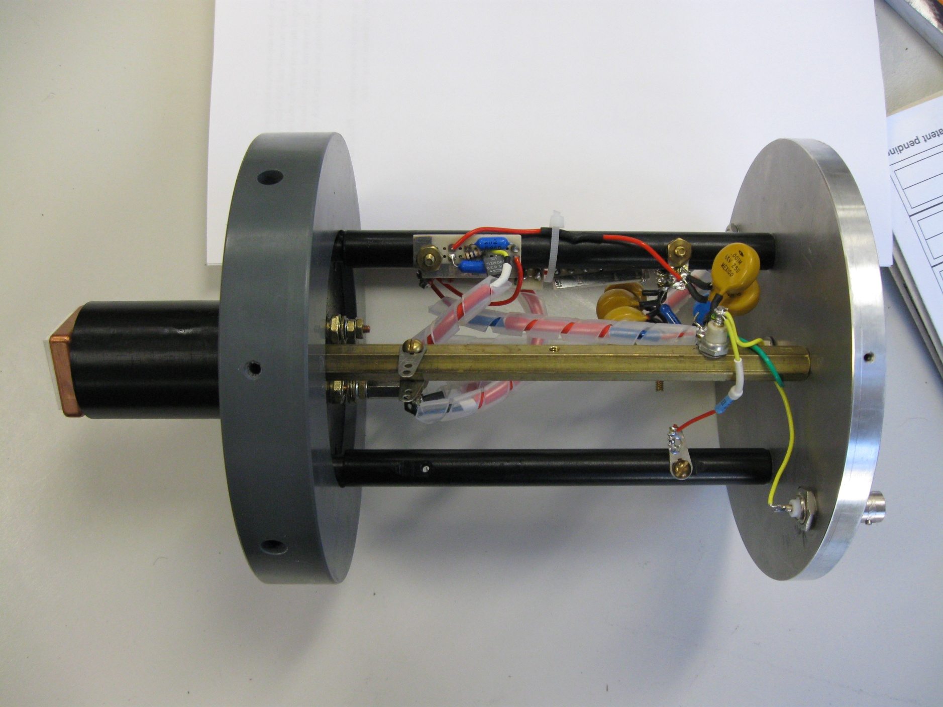

Slide 14
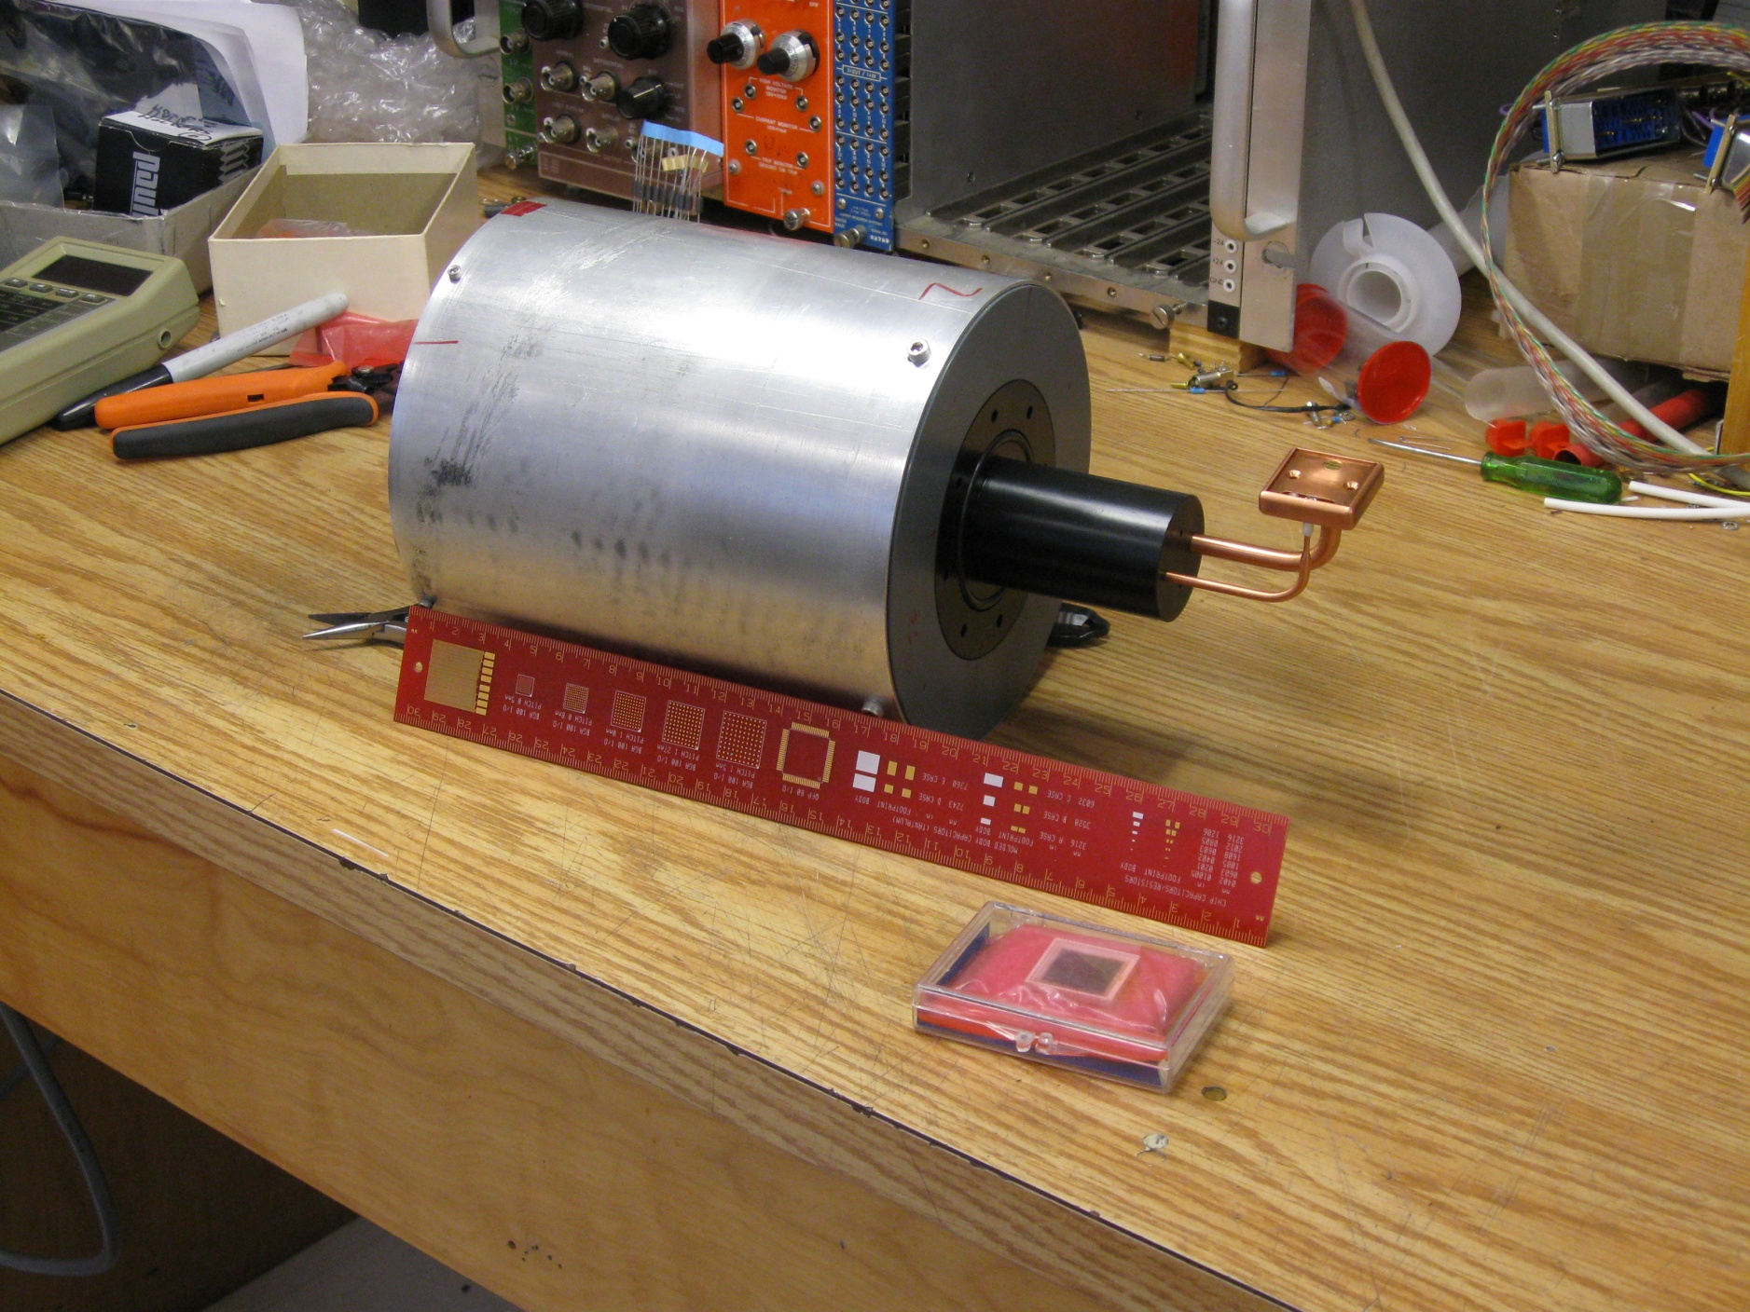

Slide 15
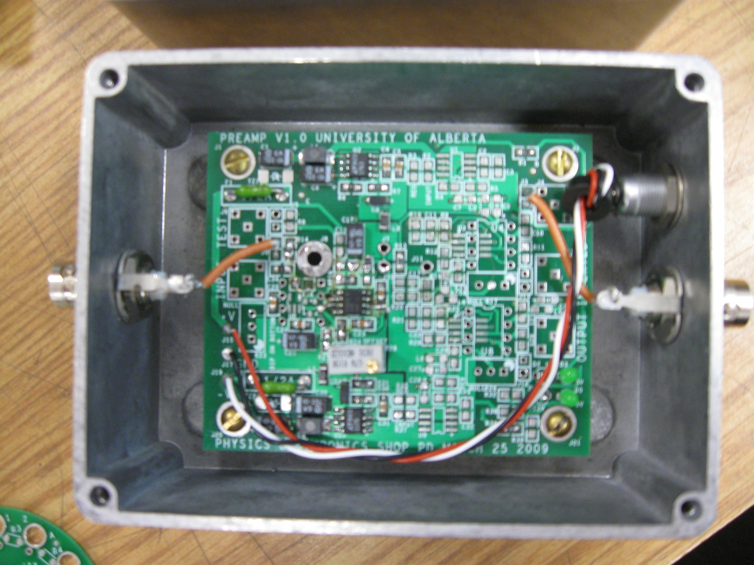

Slide 16
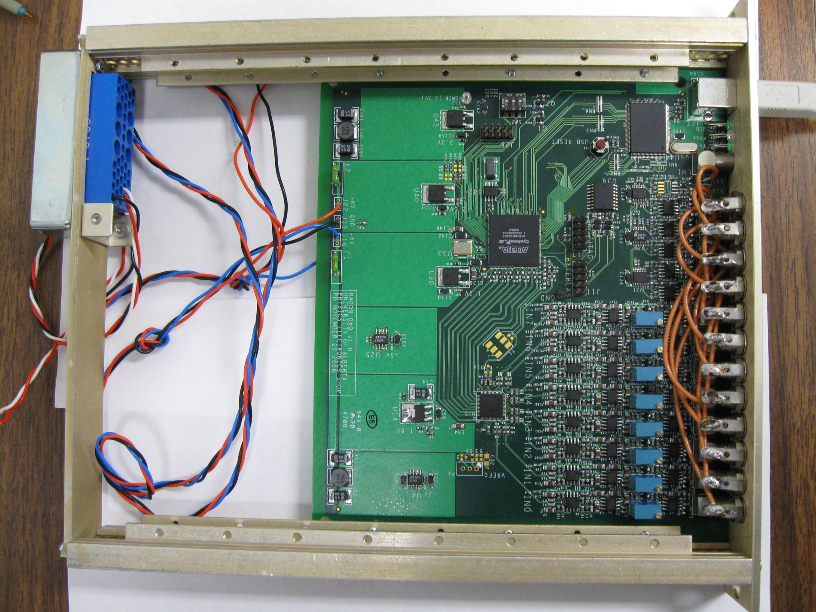

Slide 17
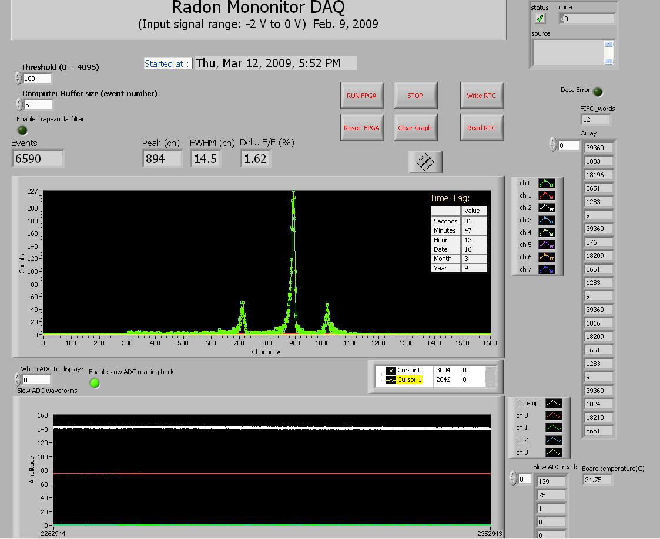

Slide 18
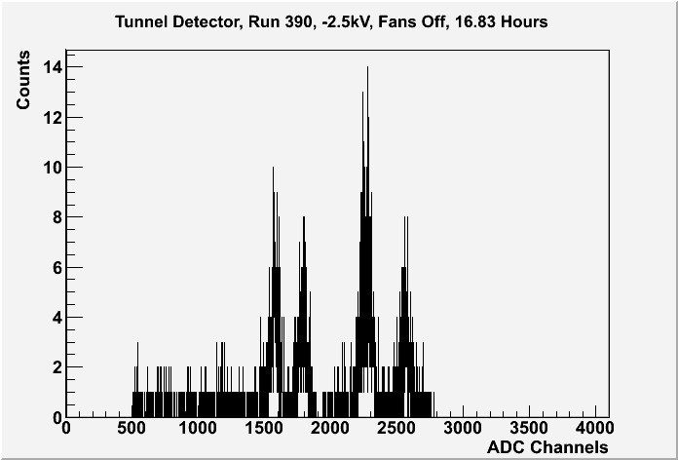
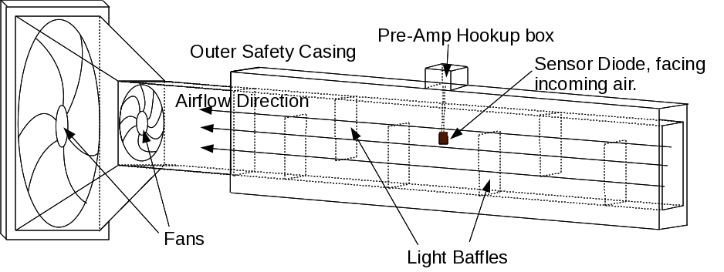
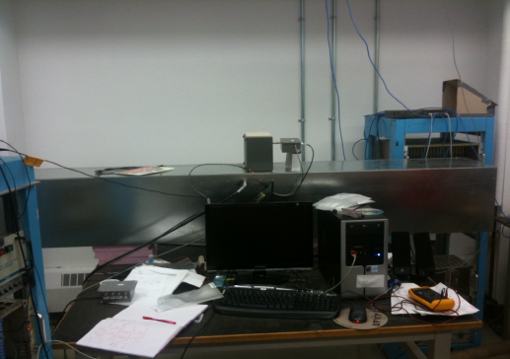
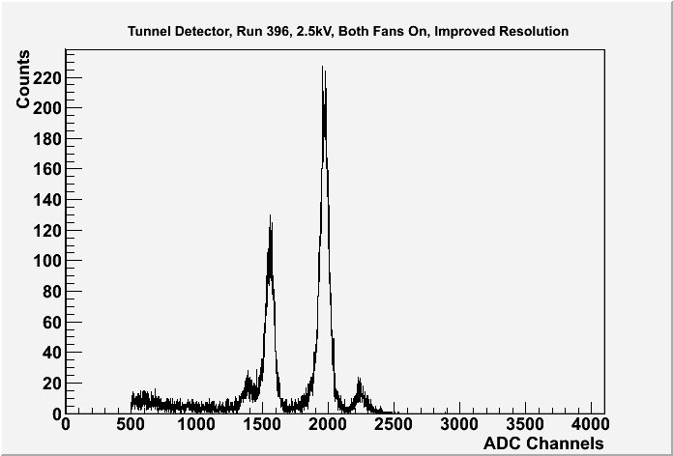
Tunnel Detector
Cross section:
20 cm x 20 cm
Air velocity ~1.8 m/s
16.8 hours: 515 counts Po214= 31/hour
40.8 hours, 16490 counts= 400/hour

Slide 19
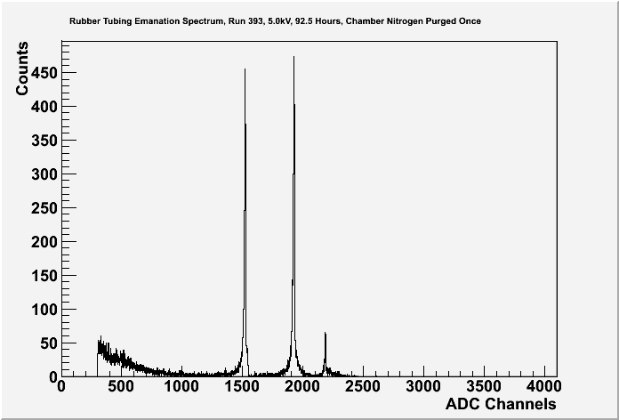
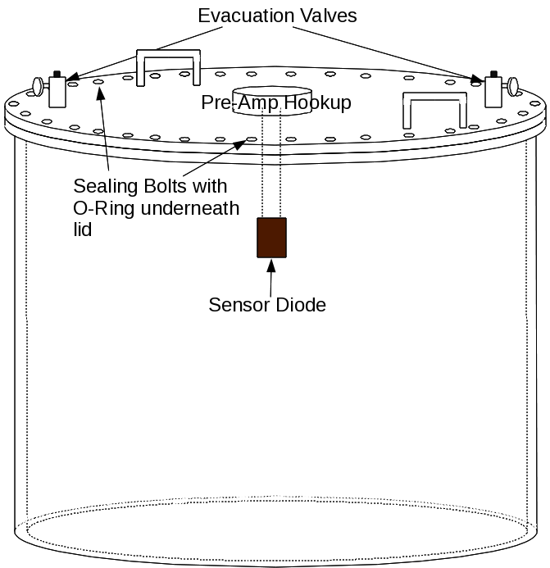
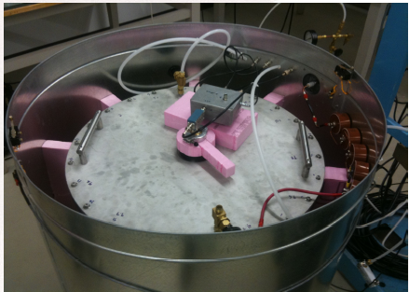
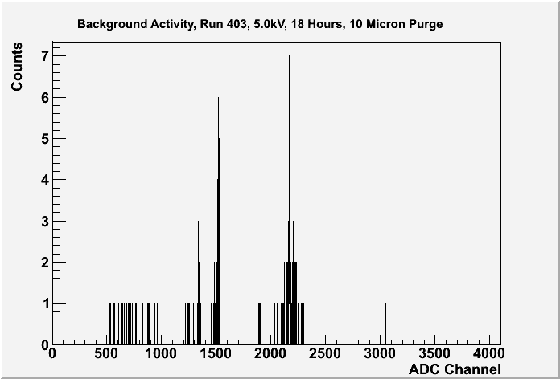
Emanation Chamber
Po210:2.4/hour
Po218(6114 MeV)::75/hour
Po214: 89/hour
Po212: 9.6/hour
Po210:1.25/hour
Bi212(6051 MeV)::3.4/hour
Po214: 0.3/hour
Po212: 6/hour
60 cm radius, 61 cm high
Volume=0.17 m**3

Slide 20
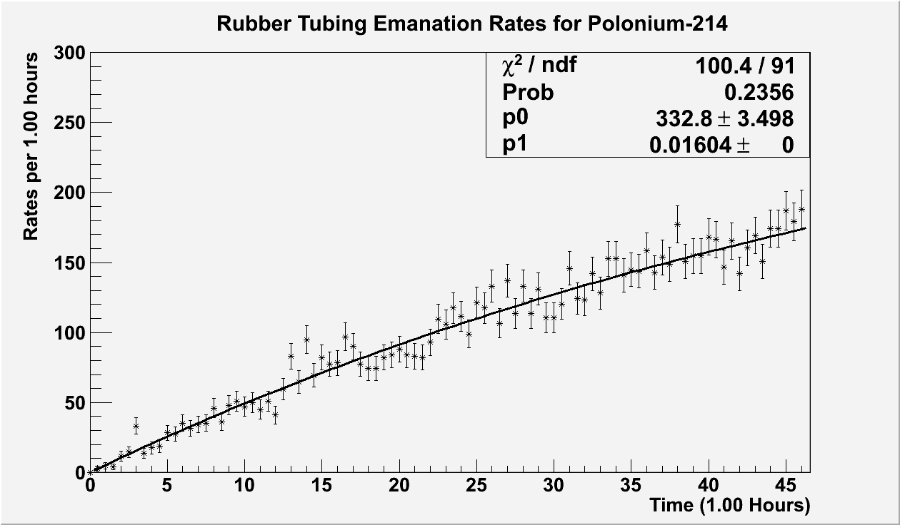
Emanation Rate

Slide 21
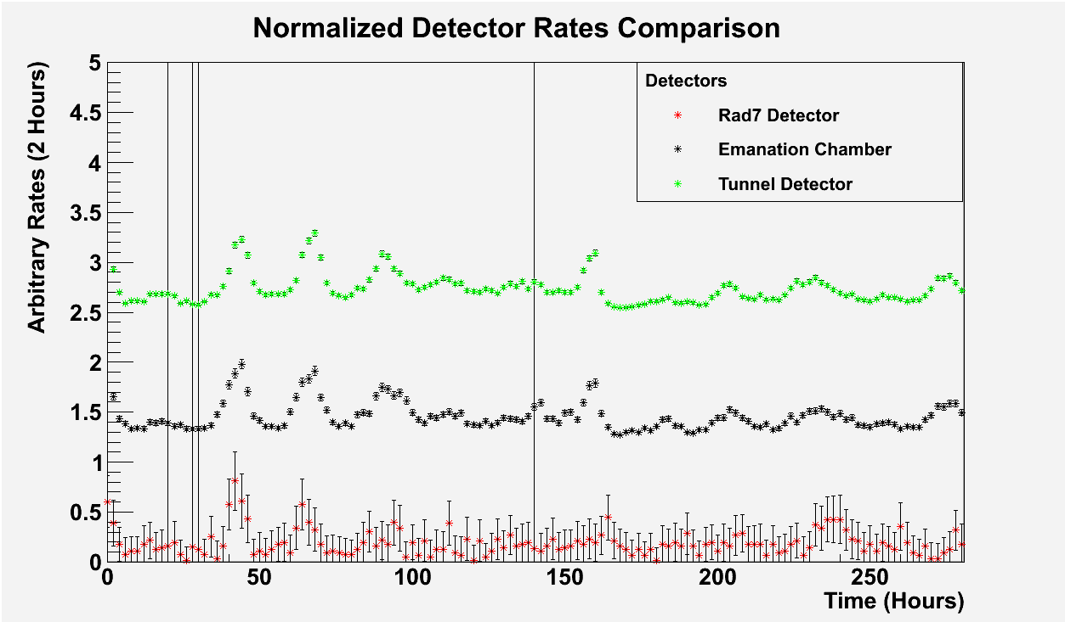
Calibration

Slide 22
Conclusions?
Radon Monitoring and radon emanation systems are well advanced and working reasonably.
Radon lab is getting into shape and will be ready and useful in 2011.
There are lots of pitfalls and snares ...

